Slide 1
INCOME TAX CALCULATOR USING GUI
Presented by : k . harshavardhan reddy
B . Chenna Krishna reddy
Yashwanth kumar
Submitted to : chavi Kapoor

Slide 2
contents
objective
description of the project
work division
about the project
conclusion and results
REFERENCES

Slide 3
objectives
To create a GUI based Income Tax Calculator and understanding its working
To create a user friendly interface using GUI so that every one can use it easily
To understand the working of every module used in the creation of Income Tax Calculator using GUI
To collect the requirements that are related Income Tax and implementing them using GUI

Slide 4
Description of the project
Good user interface
Taking input from user(amount)
Calculating the tax amount(based on the tax slab given by GOVT)
Displaying the tax amount to be paid
Quit window alert

Slide 5
Work division
Harsha
Yashwant
Chenna Krishna
GUI and calculation
Helped in ppt and final report
GUI part

Slide 6
About the income tax calculator

Slide 7
About project
Calculate the income tax for amount entered by user
Coded in python comes with graphical user interface so that any one can use it easily
It includes amount to calculate tax, tax amount and submit button

Slide 8
Let’s look at some snapshots of project

Slide 9
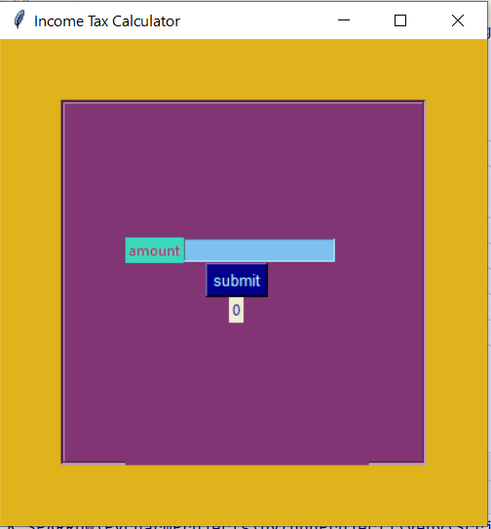
1. Our tax calculator interface

Slide 10
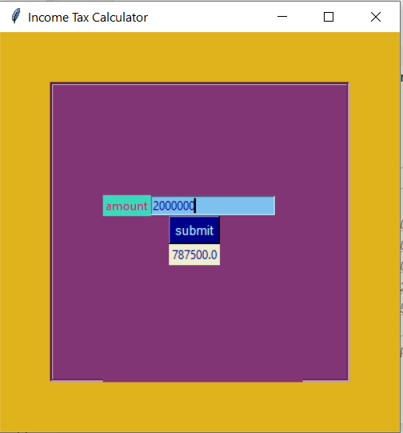
2.Tax display

Slide 11
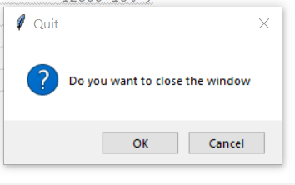
3. Widow quit alert

Slide 12
WORKING
First user enters the amount
Then we take entered amount from the entry
In code we created a function to calculate tax
In the function we check the amount entered through if condition if the amount matches to the condition then we evaluate the tax
Finally we display the tax amount

Slide 13
INCOME TAX CALCULATION
def taxamount(): a2=int(a1.get()) if a2>=250001 and a2<500000: tax=5 return entryer.set(str(a2 * (tax/100))) elif a2 >=500001 and a2 <750000: tax=10 return entryer.set(str((a2 * (tax/100)+12500))) elif a2 >=750001 and a2<=1000000: tax=15 return entryer.set(str((a2 * (tax / 100) + 37500))) elif a2 >= 1000001 and a2 <= 1250000: tax = 20 return entryer.set(str((a2 * (tax / 100) + 75000))) elif a2 >= 1250001 and a2 <= 1500000: tax = 25 return entryer.set(str((a2 * (tax / 100) + 125000))) elif a2 >= 1500001: tax =30 return entryer.set(str((a2 * (tax / 100) + 187500))) else: return entryer.set("0")

Slide 14
CONCLUSSION AND RESULT
. Finally created Income Tax Calculator that include all of the modules mentioned above
. Learned to make application using GUI in Python
. The application is capable of calculating the tax for amount entered by user

Slide 15
REFERENCES
Class videos
W3 schools
Geekforgeeks
Google.com

Slide 16
THANK YOU

